Slide 1
2018 Financial Literacy Awards Ceremony

Slide 2
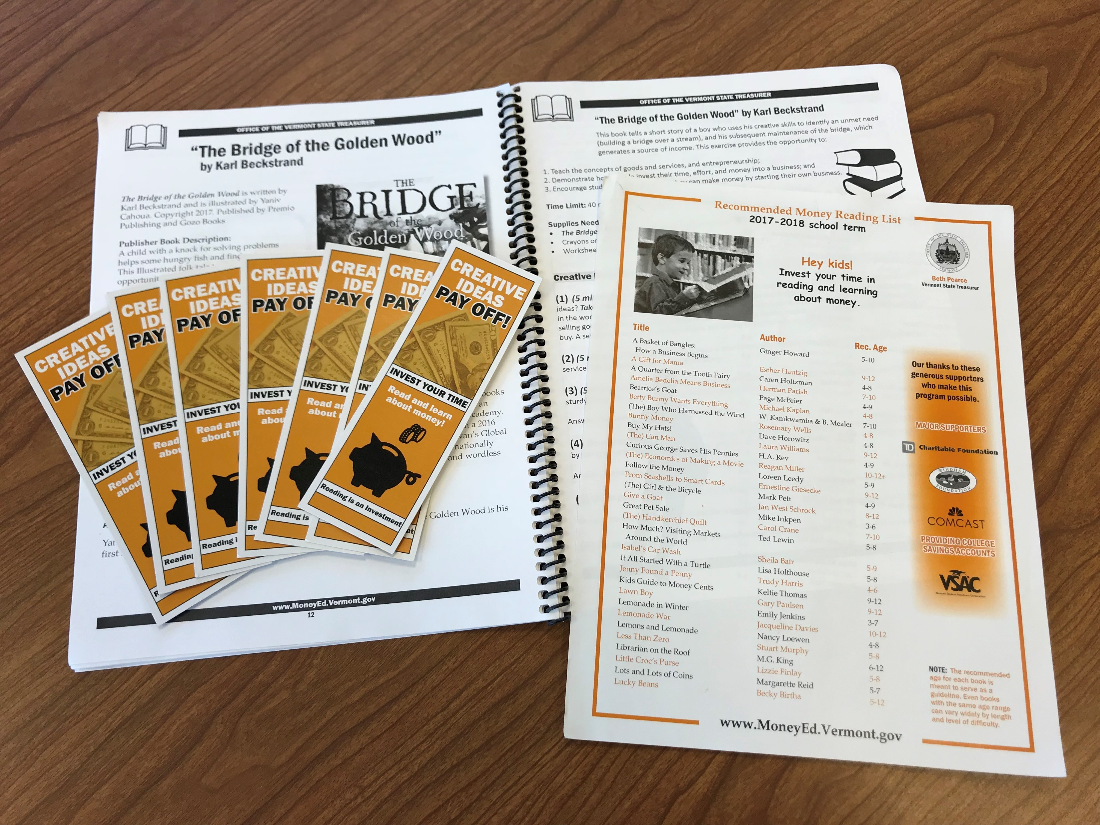
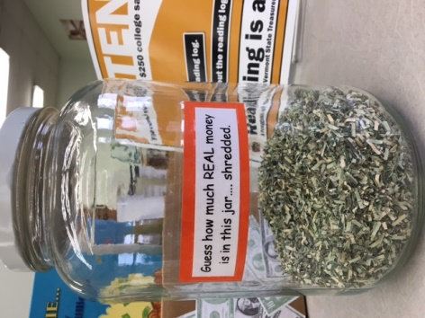
Reading is an Investment
2017-2018 Curriculum Theme: Creative Ideas Pay Off!

Slide 3
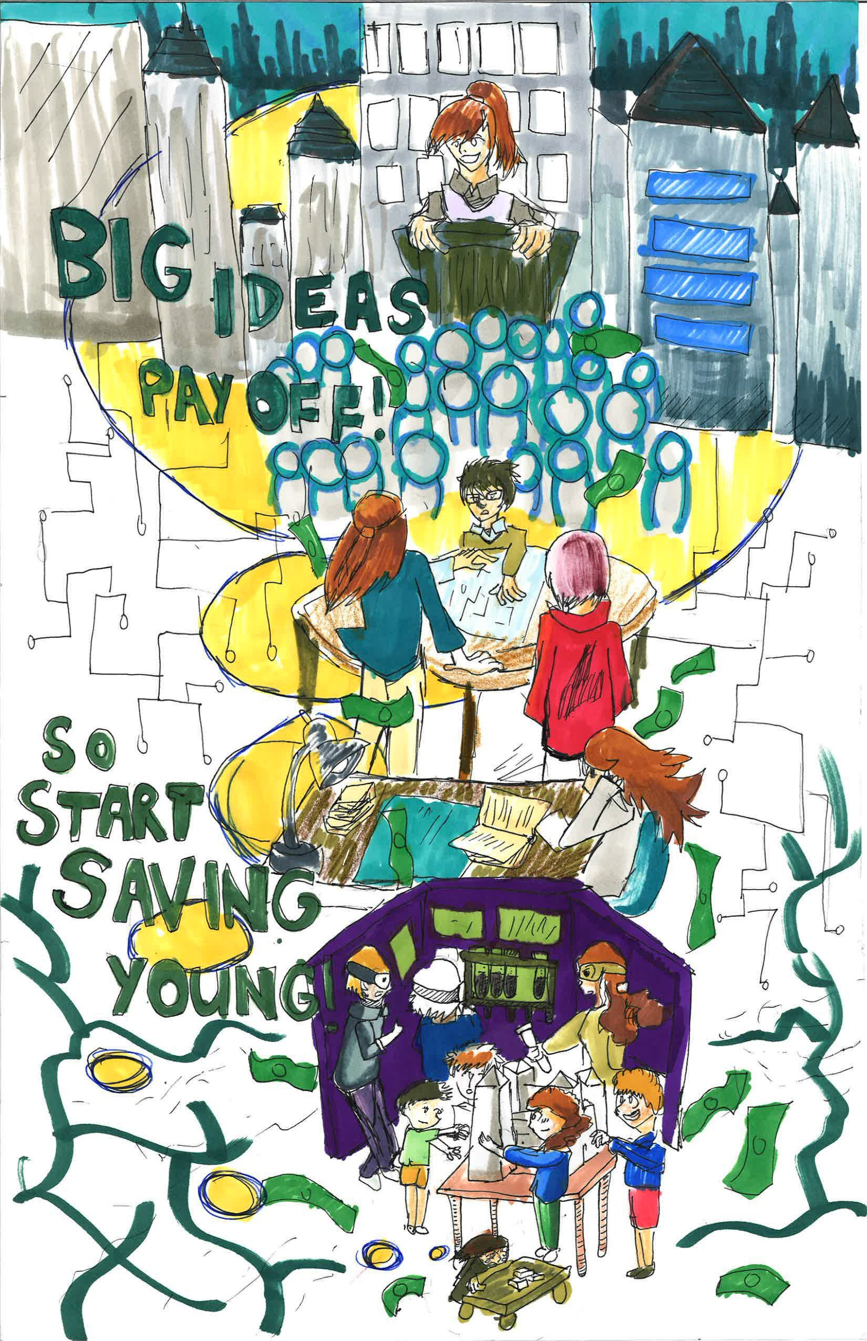
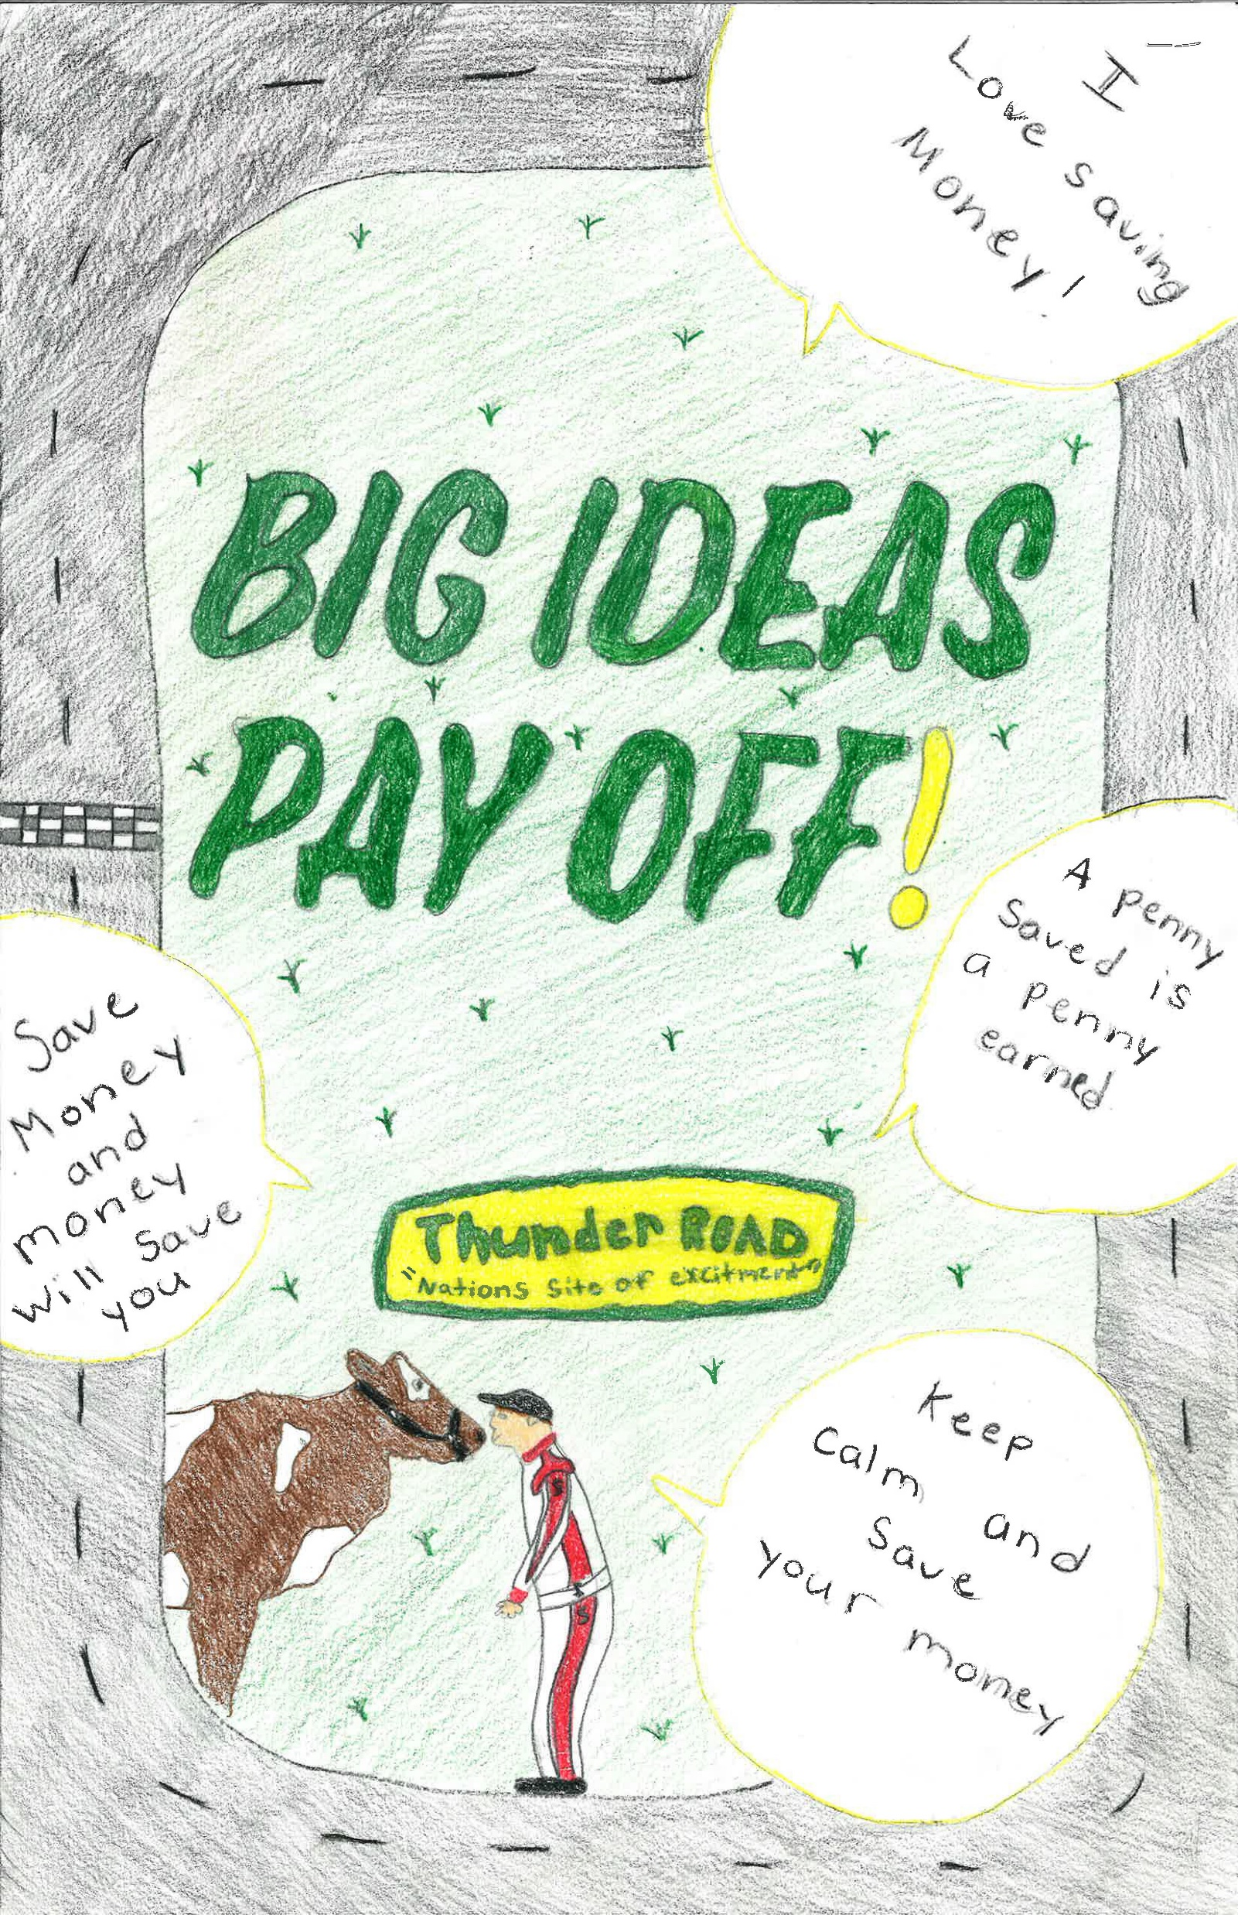
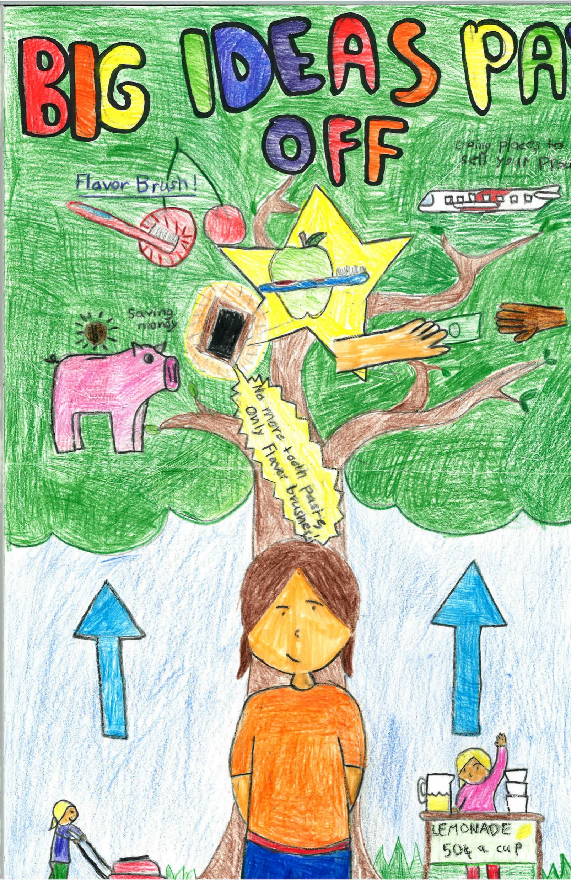
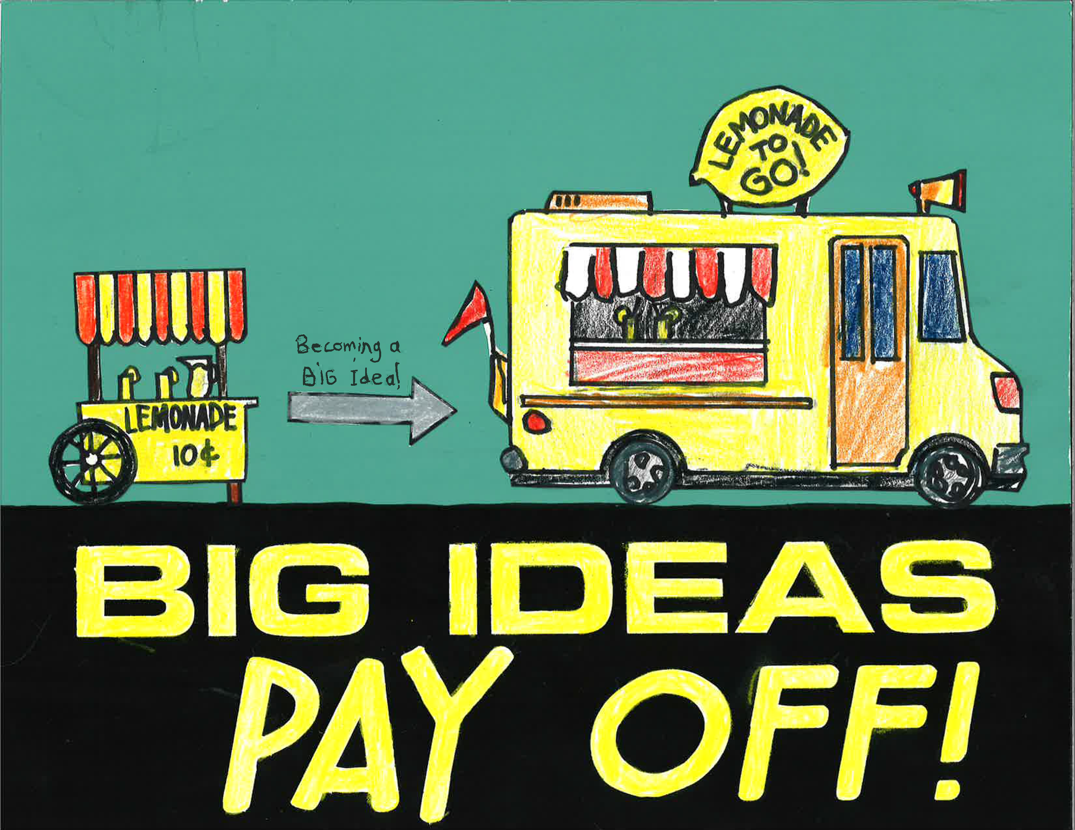
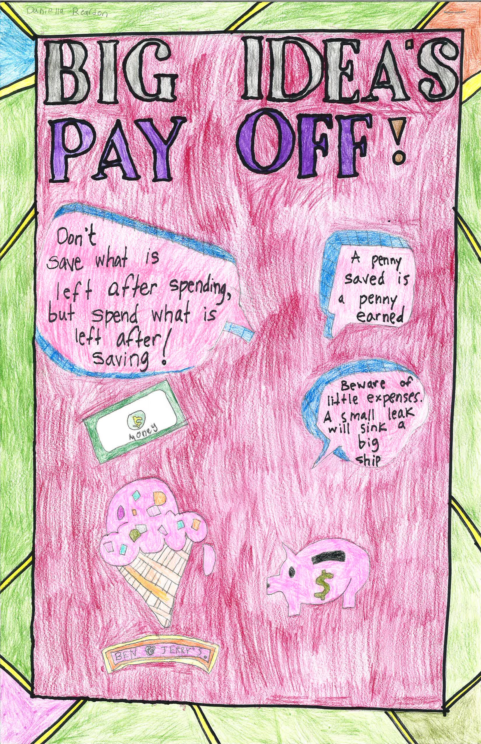
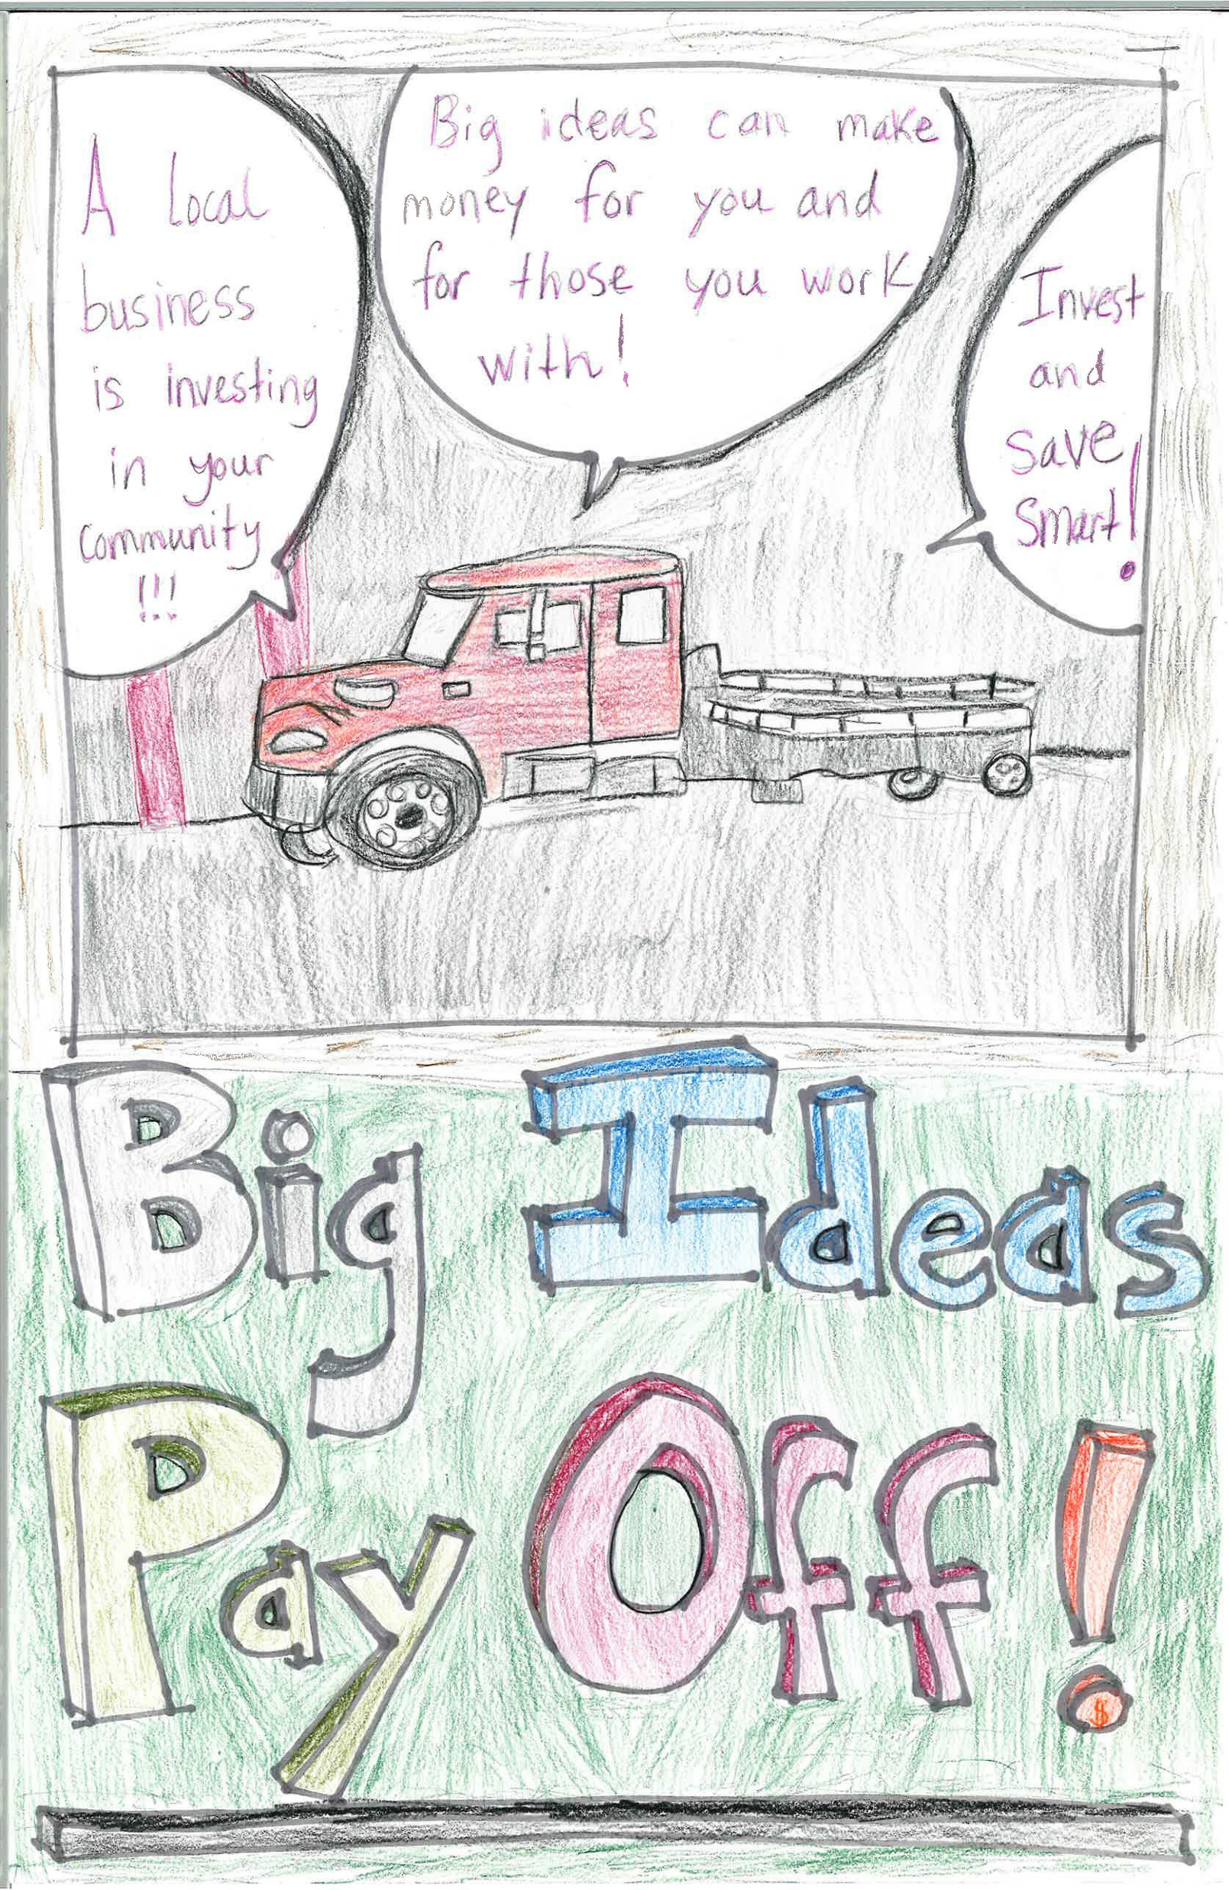
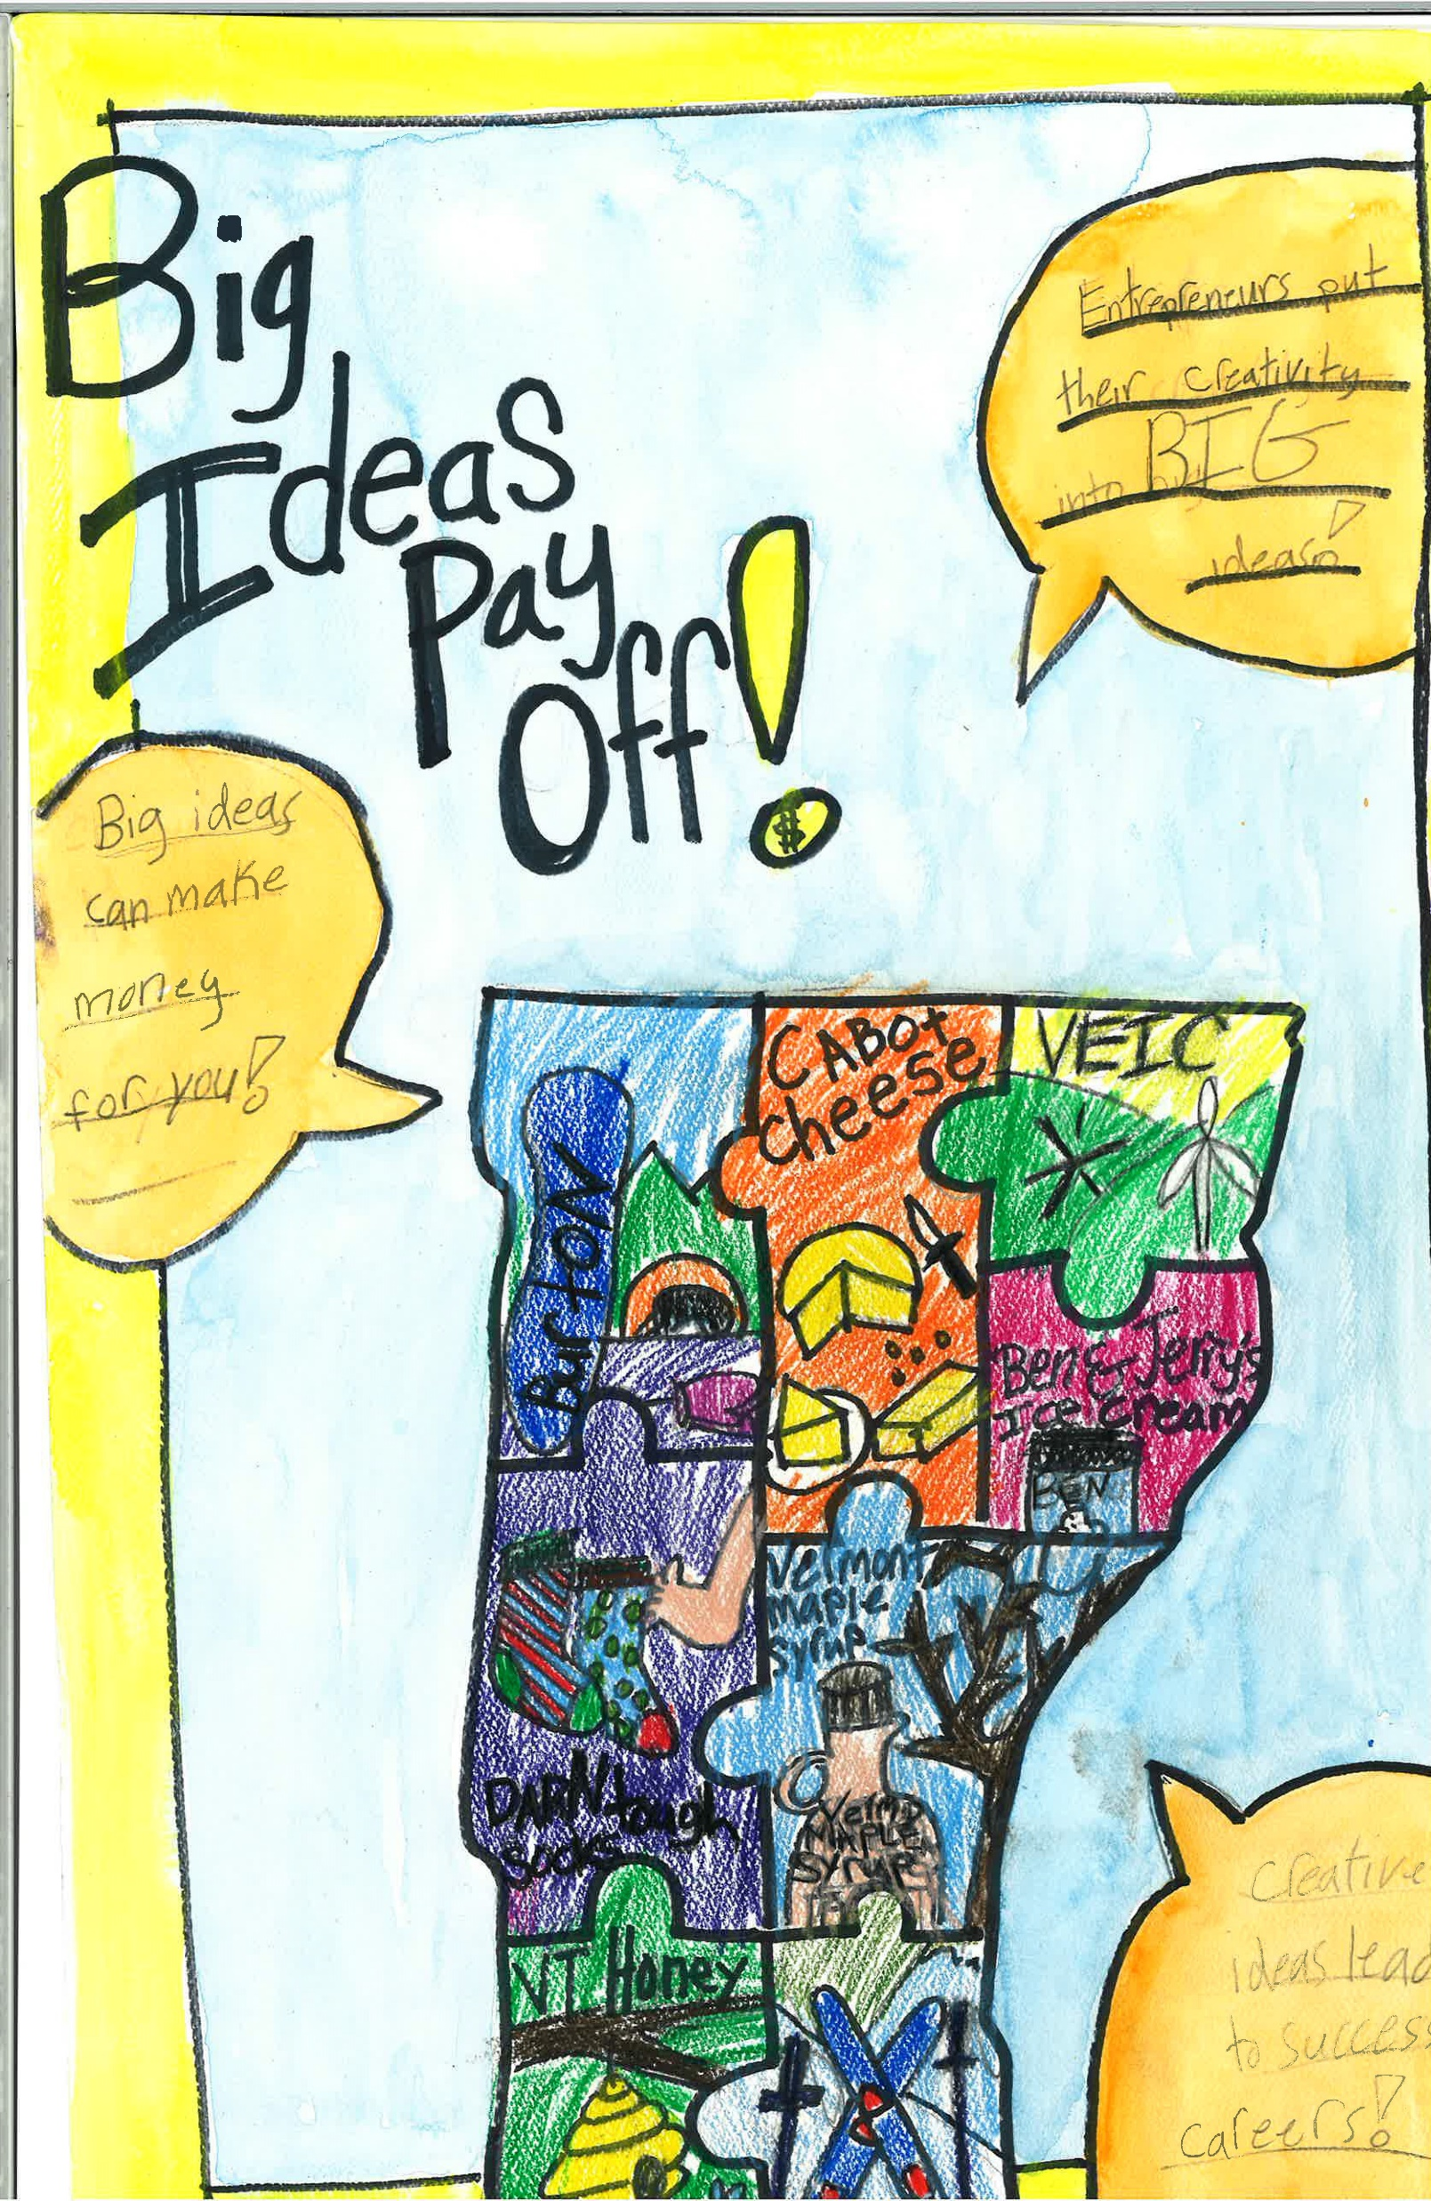
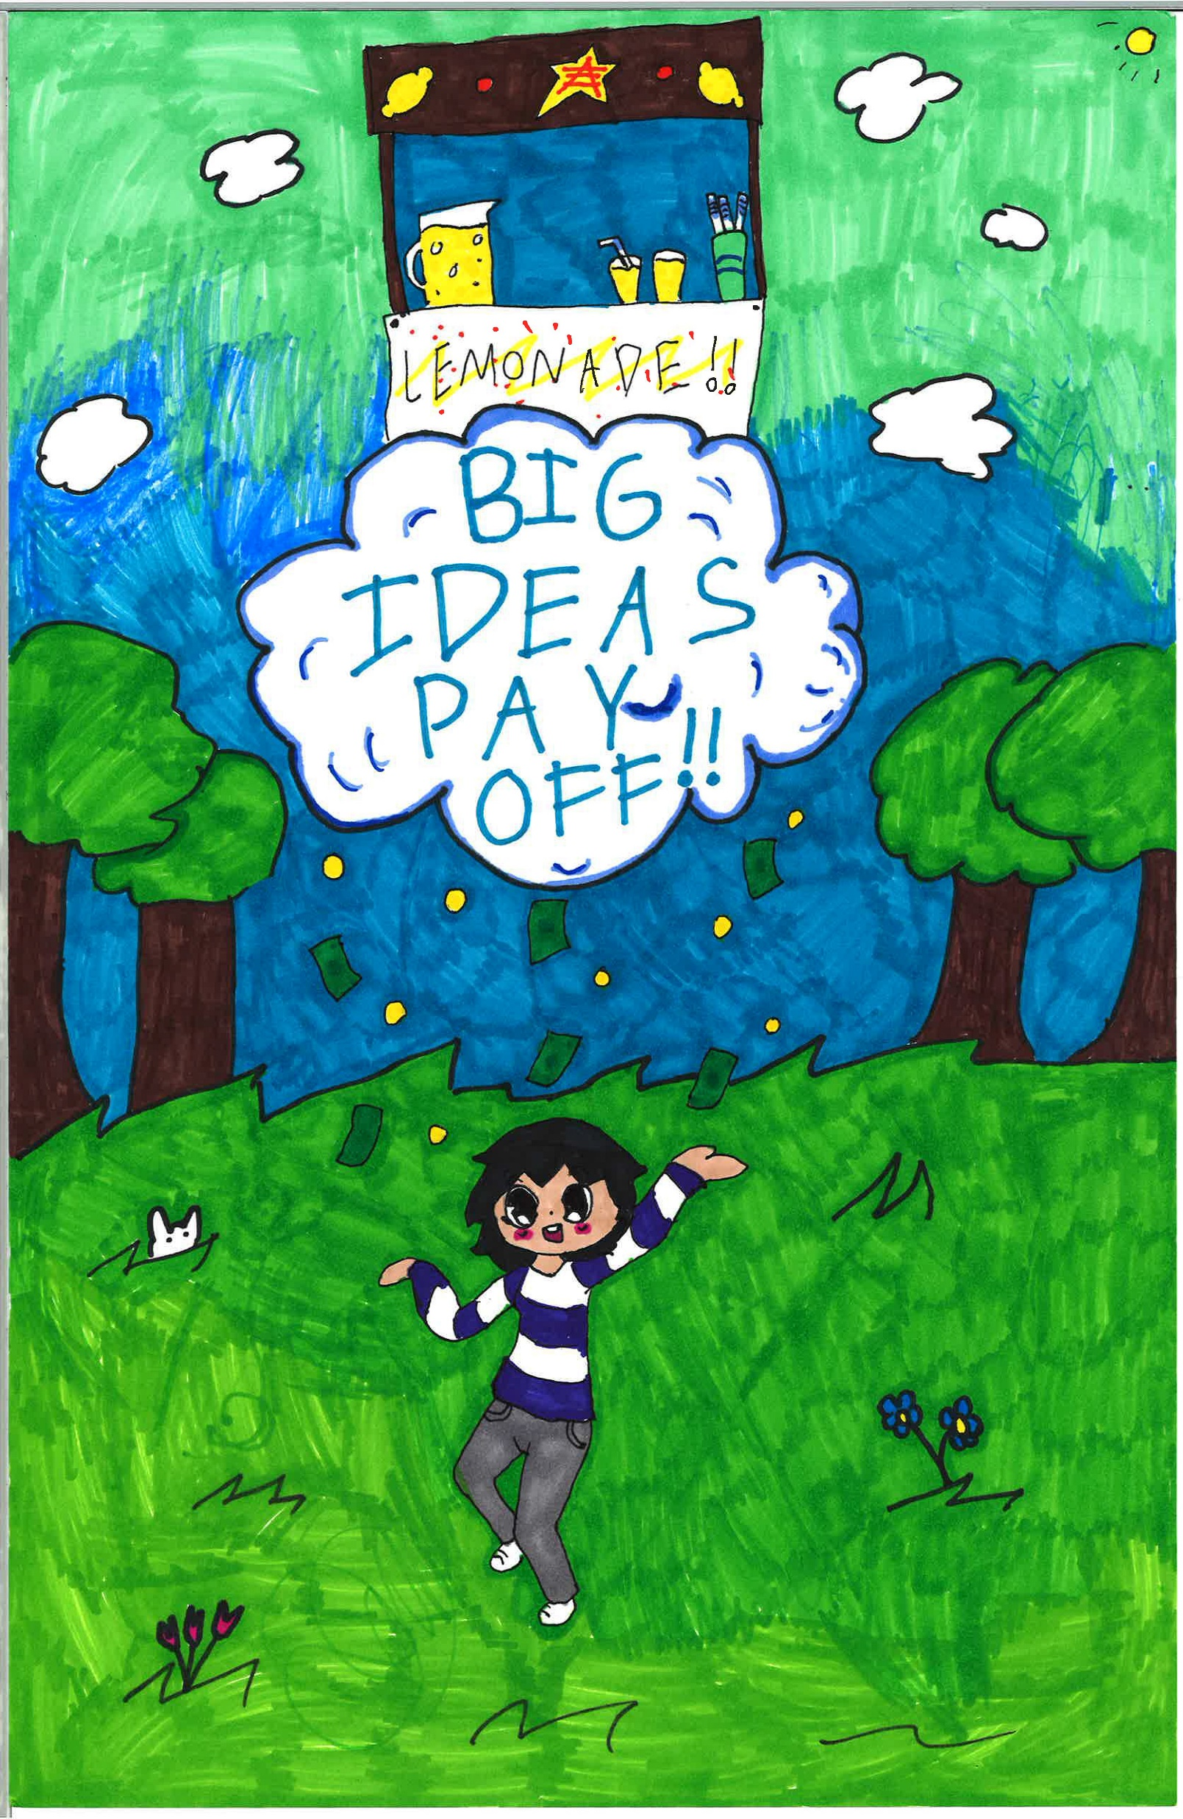
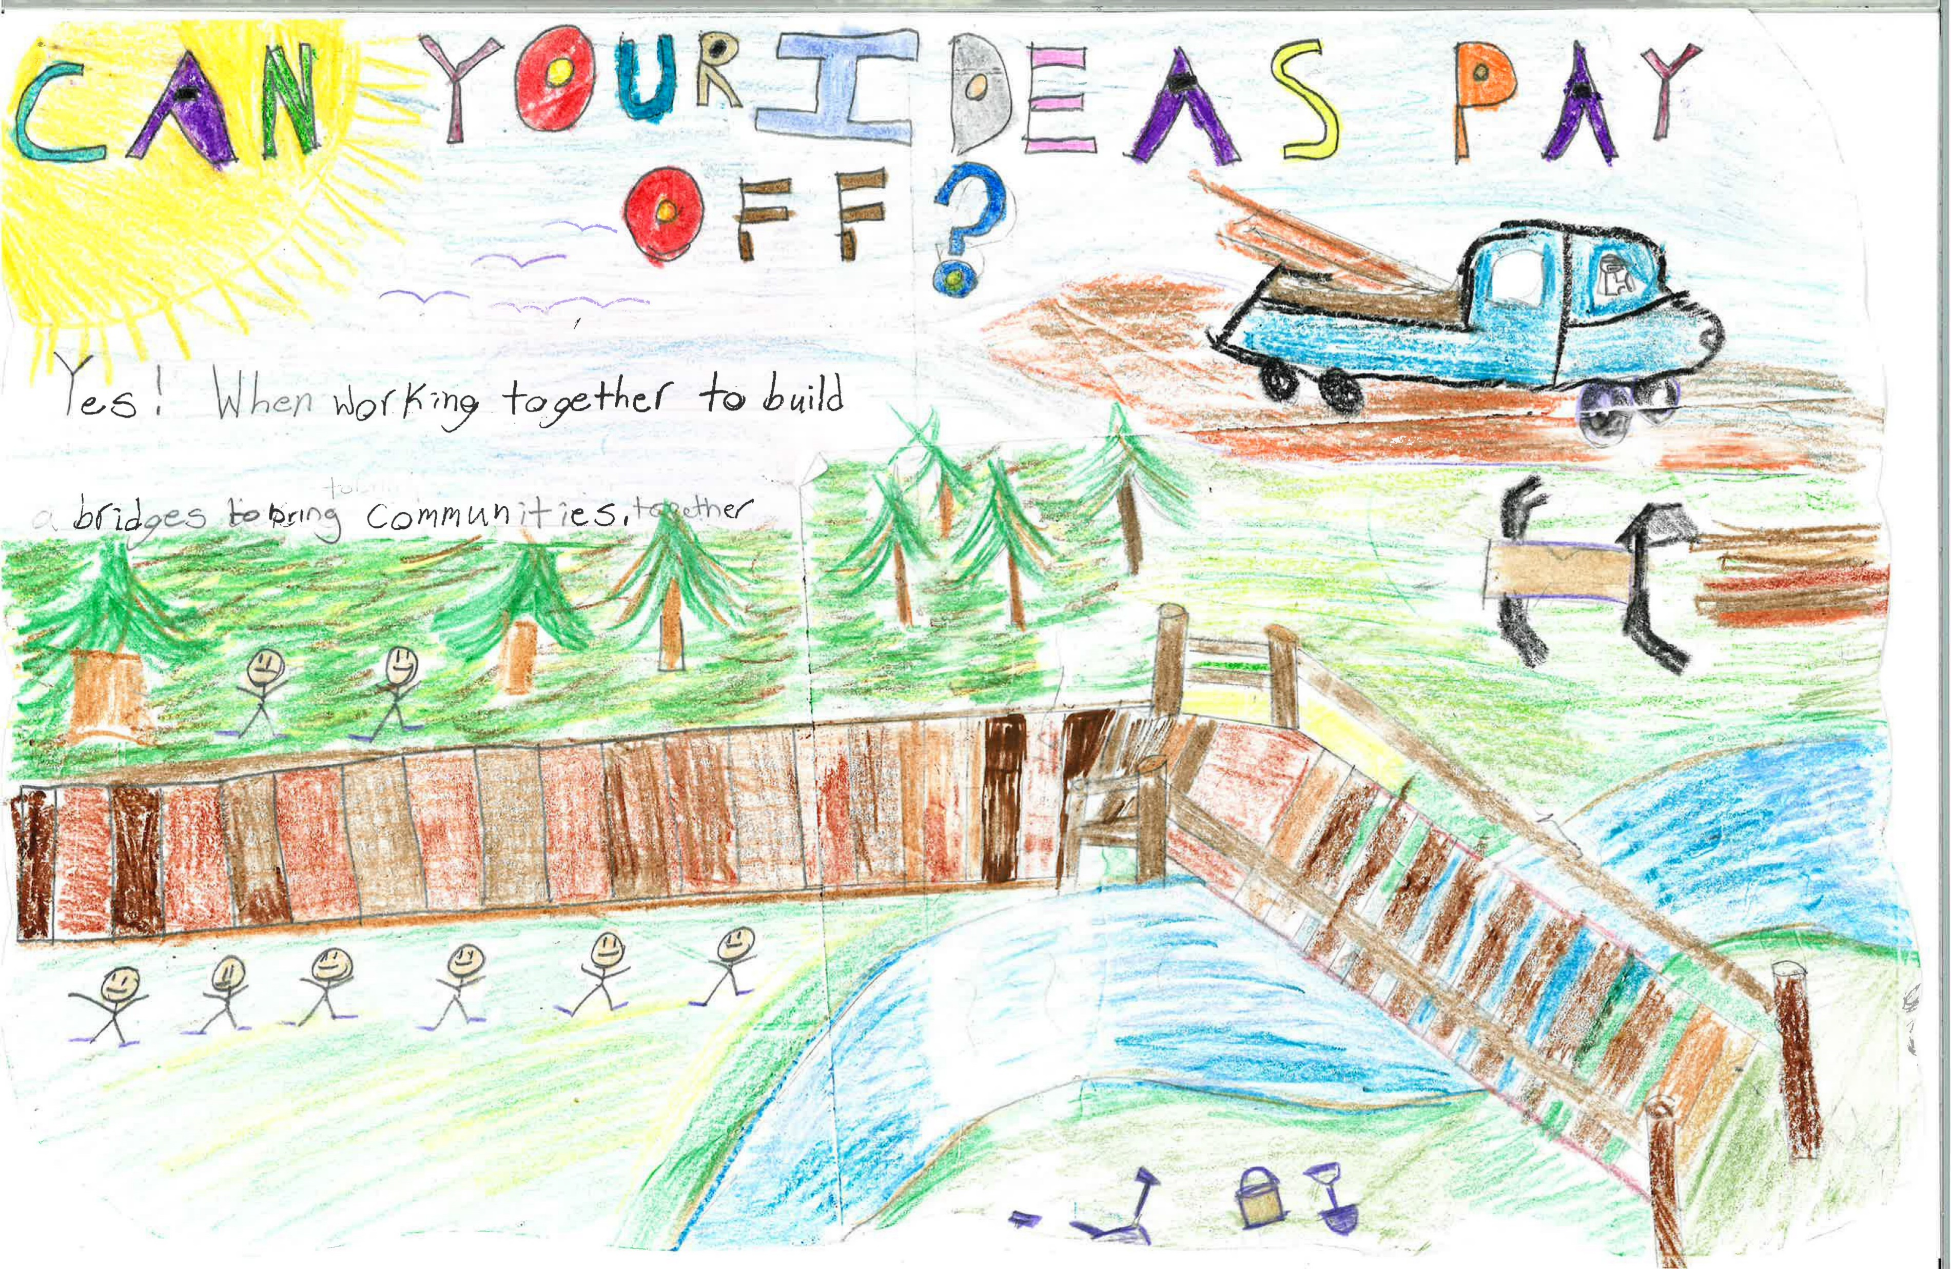
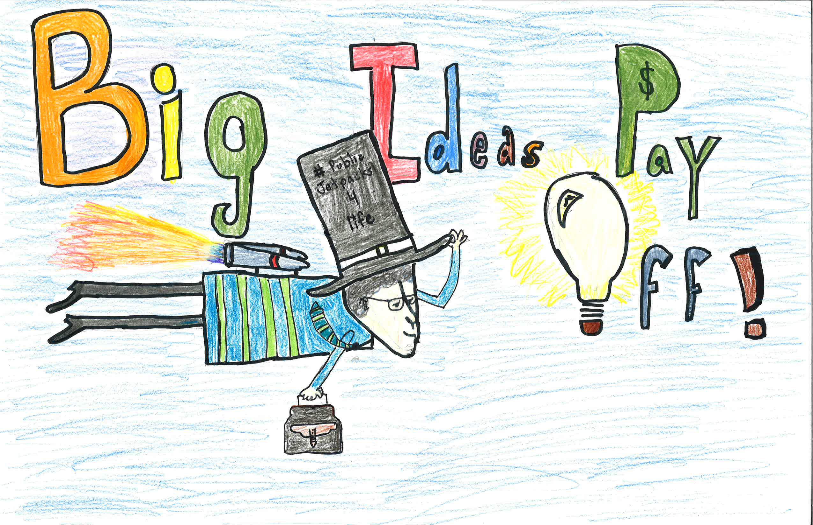
2018 Be Money Wi$e Poster Contest
2018 Contest Theme: Big Ideas Pay Off!

Slide 4
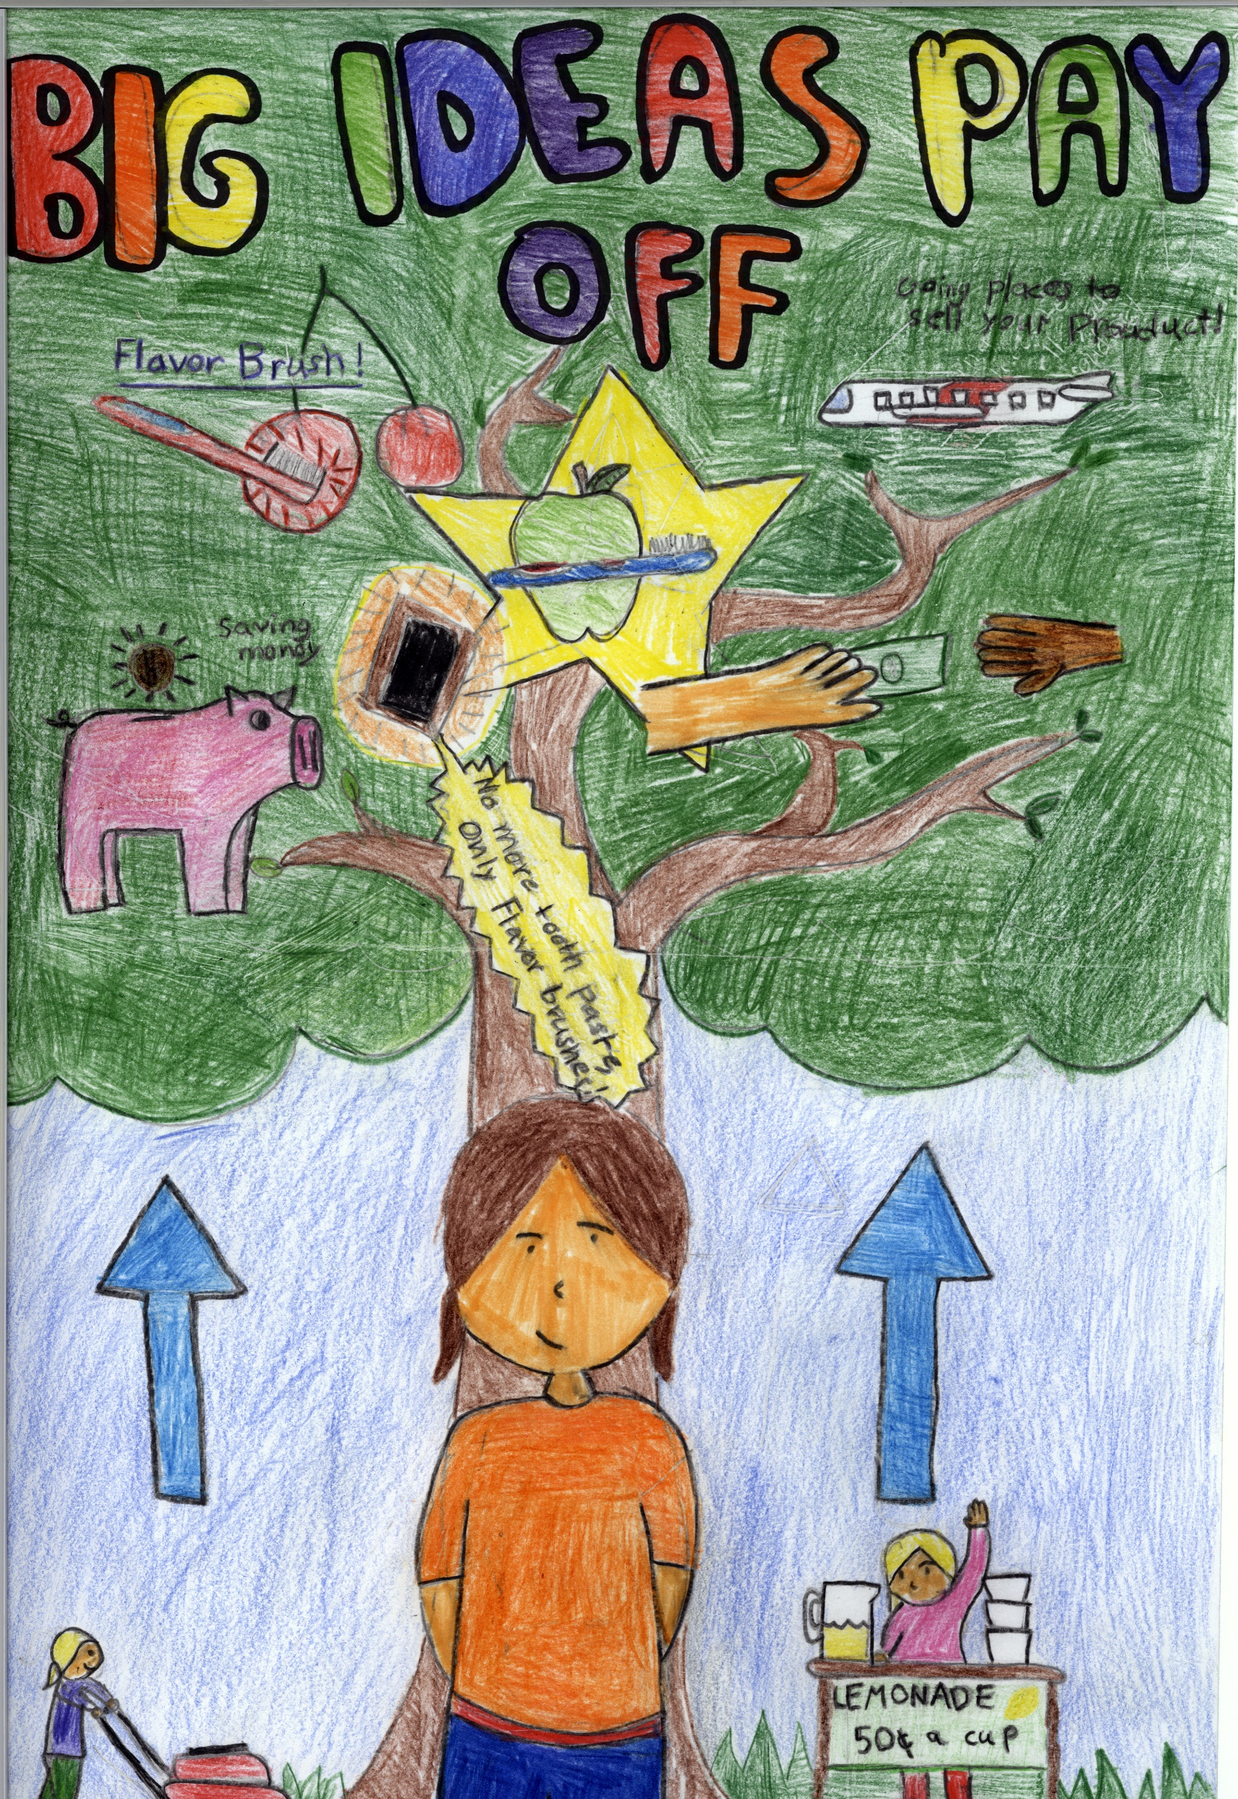
2018 Be Money Wi$e Poster Contest
Student Artists Achieving Honorable Mention

Slide 5
3rd Place – Elementary School
Madlyn Shedd, 4th Grade
Samuel Morey Elementary

Slide 6
3rd Place – Middle School
Emerson Rice, 6th Grade
Vergennes Union Elementary

Slide 7
2nd Place – Elementary School
Monica King, 4th Grade
Fletcher Elementary School

Slide 8
2nd Place – Middle School
Noah Rubel, 8th Grade
Barre City Elementary & Middle School

Slide 9
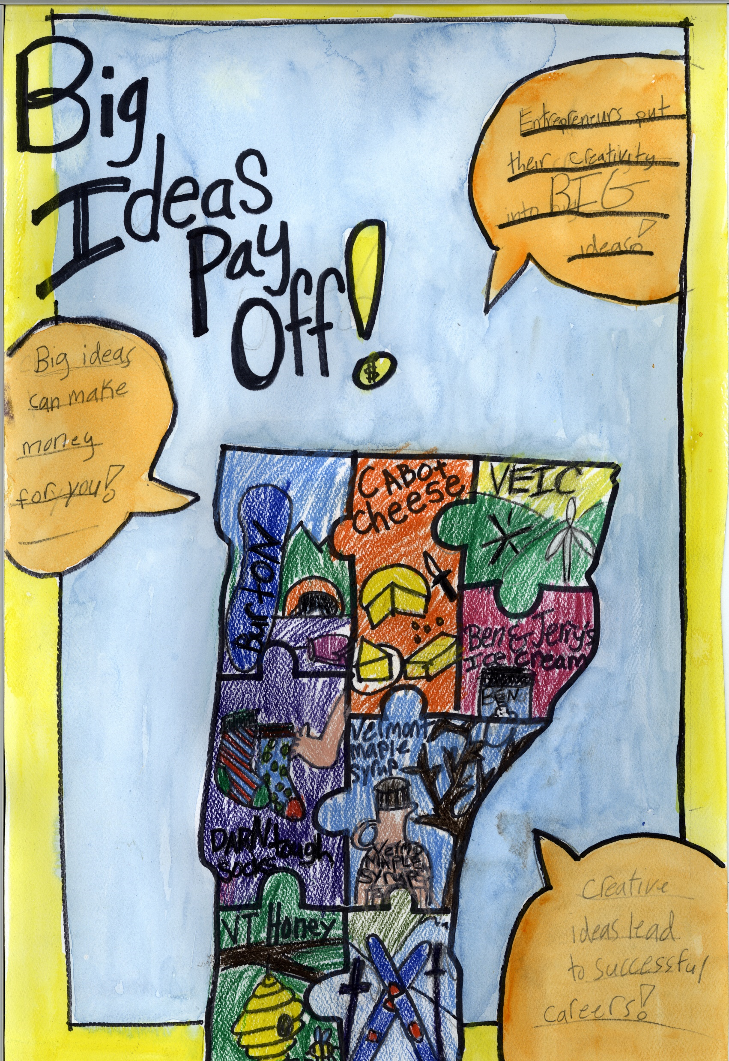
1st Place – Elementary School
Ziva Baker, 3rd Grade
Mater Christi School

Slide 10
1st Place – Middle School
Bryce Ruohonen, 9th Grade
Craftsbury Academy

Slide 11
2018 Financial Literacy Awards Ceremony

